Slide 1
Networking Project
Comprehensive secure network design of a company
with two floors or more.

Slide 2
Contents of this presentation
Introduction | Just a quick introduction about the project.
Team Members | Introducing team members and their roles in the project.
Project Description | Description of the poroject and what it can do.
Project Overview | Explaining the project.
Test Connectivity | A detailed look at the connectivity between the devices.
Conclusion | Description of the problems that the project overcame.

Slide 3

Introduction
In a rapidly growing organization, expansion often brings new challenges. One such challenge is designing a robust and scalable network for a new building housing number of employees. With multiple departments spread across three floors, a seamless and secure network infrastructure is essential to support daily operations. This project focuses on implementing a future-proof network solution using a hierarchical model, ensuring redundancy, security, and scalability. Leveraging technologies like VLANs, OSPF, and DHCP, the design aims to meet current needs while allowing for future growth.

Slide 4
Project Description
This project involves designing and implementing a network for a new building housing 600 staff across six departments. Using a hierarchical model with redundancy at each layer, the network will ensure reliability and security. Key features include VLAN configuration, subnetting, OSPF routing, and dynamic IP addressing via DHCP. Wireless connectivity will be provided for all departments, with port security in place for sensitive areas. The network will also connect to two ISPs for high availability.

Slide 5
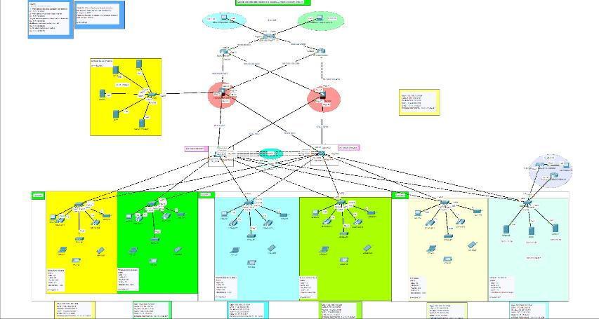
Network Toplogy

Slide 6
Network Overview
1
Three Floors
Distinct departments with unique roles and requirements.
2
Devices used:
PCs, printers, VoIP, ACL,
Firewalls, and servers deployed.
3
Configurations
Notes:
IP==DHCP

Slide 7
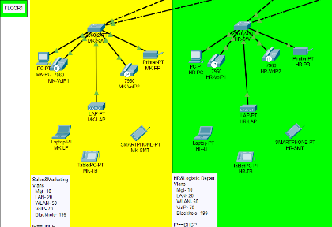
Floor 1 - Marketing and HR Departments
Devices:-
- PCs, Printers, VoIP phones, Laptops, Tablets, Smartphones, Switch 2960-24TT.
Access Control List (ACL):-
- implemented for secure traffic management.
IPs & VLANs:-
- IP Range: 192.168.10.0/24
- VLANs: Management (10), LAN (20), WLAN (50), VoIP (70), Blackhole (199).

Slide 8
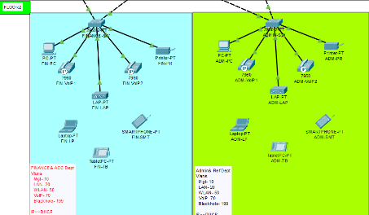
Floor 2 - Finance and Admin Departments
Devices:-
- Similar setup: PCs, Printers, VoIP, Switch 2960-24TT, ACL, Laptops, Tablets, Smartphones.
IPs & VLANs:-
- IP Range: 172.16.0.0/16
- VLANs: Same as Floor 1.
Role of Departments:-
- Finance: Securing financial transactions and records.
- Admin: Internal office management and coordination.

Slide 9
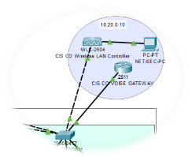
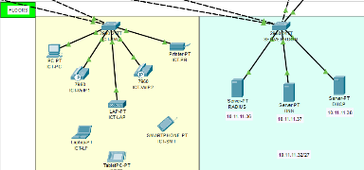
Floor 3 - ICT Department and Server Room
Devices in ICT:-
- Similar to other floors (PCs, VoIP, etc.).
- VLANs and IP ranges same as previous floors.
Server Room:-
- Devices:-
- Switch 2960-24TT, WLC-2504, Router 2811 (Voice Gateway), DHCP Server, DNS Server, RADIUS Server.
- IPs & VLANs:-
- IP Range: Inside Server (10.11.11.32/27), VLAN 90 for inside servers.
- Purpose of Components:-
- Wireless LAN Controller (WLC-2504): Manages wireless network connections.
- Voice Gateway (Router 2811): Connects VoIP phones to the external PSTN network.

Slide 10
Network Architecture - Server Overview
A detailed look at the server components
within the network architecture.

Slide 11
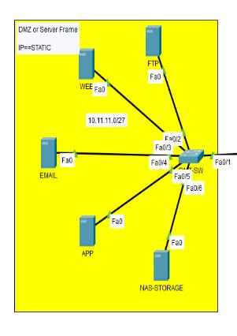
Server infrastructure overview
Key areas include:-
DMZ (Demilitarized Zone)
Application, Email, and NAS storage servers
Connections to VLANs (Virtual Local Area Networks)

Slide 12
DMZ Server Configuration
Servers in the DMZ include:-
Application Server (IP: 10.13.13.x/27):
Hosts external/internal applications.
Email Server (IP:10.13.13.x/27)
Manages email traffic.
NAS Storage (IP: 10.13.13.x/27): Centralized storage for the network.

Slide 13
Internal Servers
Internal servers segmented across VLANs:
- VLAN 20 Servers (IPs: 10.11.11.1, 10.11.11.27) handle internal operations such as data processing and user management.

Slide 14
Server Interconnections
Servers are interconnected via:-
LACP bonds (Link Aggregation Control Protocol) for better bandwidth and redundancy.
Traffic routing through firewalls for security.

Slide 15
Server Security
01
02
About usFirewalls protect the DMZ and internal servers:-
Firewalls ensure secure traffic flow between external and internal network segments.
Active-Standby firewalls provide redundancy for
high availability.

Slide 16
Network Architecture – Cloud Overview
A detailed look at the cloud components
within the network architecture.

Slide 17
What is Cloud Computing?
Cloud computing is a model that enables convenient on-demand access to a shared pool of configurable computing resources
(e.g., networks, servers, storage, applications, software)
that can be rapidly provisioned and released with minimal management effort. Essentially it's like renting computing power and resources
from a remote data center over the internet rather than owning and maintaining your own hardware.

Slide 18
Components of Cloud Computing
Hardware | Servers: The foundation of cloud infrastructure, providing computing power for various applications and services. Storage: Devices like hard drives, solid-state drives (SSDs), and object storage systems used to store data. Networking Equipment: Switches, routers, and firewalls that facilitate communication and connectivity within the cloud environment.
software | Operating Systems: The software that manages hardware resources and provides a platform for applications. Hypervisors: Software that creates virtual machines (VMs) on physical hardware, enabling multiple applications to run simultaneously. Cloud Management Platforms: Tools that help manage and automate cloud resources, such as provisioning, monitoring, and billing. Applications: The software that users interact with, such as email, databases, and web applications.
network | Internet: The global network that connects cloud providers to users. Data Centers: Facilities that house servers, storage, and networking equipment. Connectivity: The infrastructure that enables communication between data centers and users.
Services | Infrastructure as a Service (LAAS): Provides basic computing resources, including servers, storage, and networking. Platform as a Service (PAAS): Offers a development environment for building and deploying applications. Software as a Service (SAAS): Delivers applications over the internet, eliminating the need for local installation.
Security | Access Controls: Mechanisms to restrict access to cloud resources based on user roles and permissions. Encryption: Techniques to protect data from unauthorized access. Data Backup and Recovery: Procedures to ensure data integrity and availability in case of failures.

Slide 19
Key functions of hybrid cloud management platform
01
03
02
04
Cost management
Release and deployment orchestration
Allow to set flexibility for cloud solutions and maximize Roll.
Allow developers to automate test and production.
Self- service
Workloads and cost analytics
Allow users to manage, consume and terminate workloads irrespective of underlying layout.
Data relates to what work is done on hybrid and cost incurred.

Slide 20
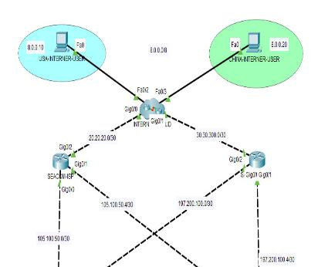
Key Elements and Potential Cloud Implications:-
Users (PC-PT): These could represent virtual machines or containers running on a cloud platform, accessed by users remotely.
Router (INTERNE-D): This could be a virtual router within a cloud network, managing traffic between different virtual networks or subnets.
Network Segments (8.0.0.0/8, 30.30.300.0/30, 20.20.20.0/30): These could represent virtual private clouds (VPCs) within a cloud environment, providing isolated networks for different workloads or tenants. Switch (211): This could be a virtual switch within a cloud network, connecting multiple virtual machines or containers within a VPC.

Slide 21
Verifying And Test Connectivity
A detailed look at the connectivity between the devices

Slide 22
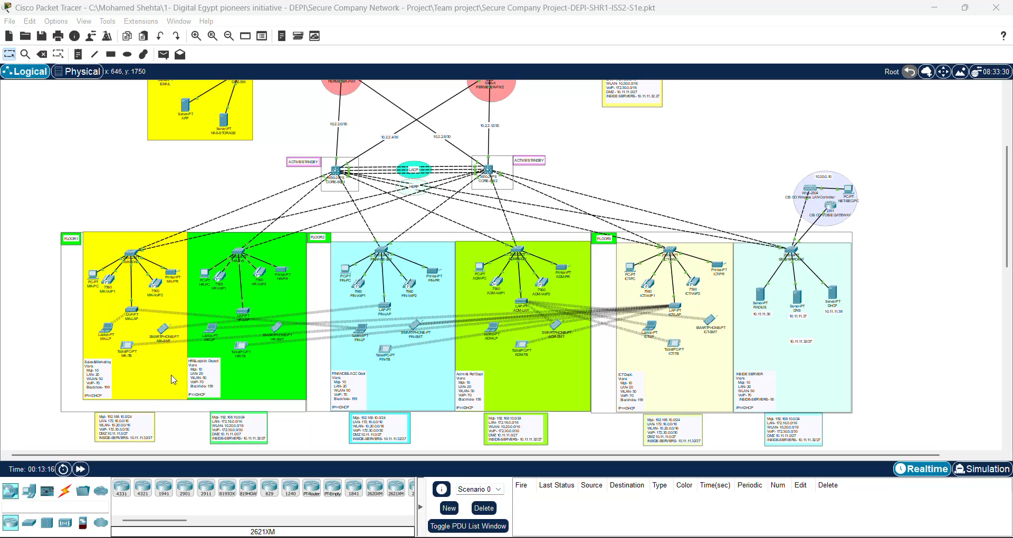
Verifying and Test Configuration
The DHCP test is used to verify the functionality of the DHCP service.

Slide 23
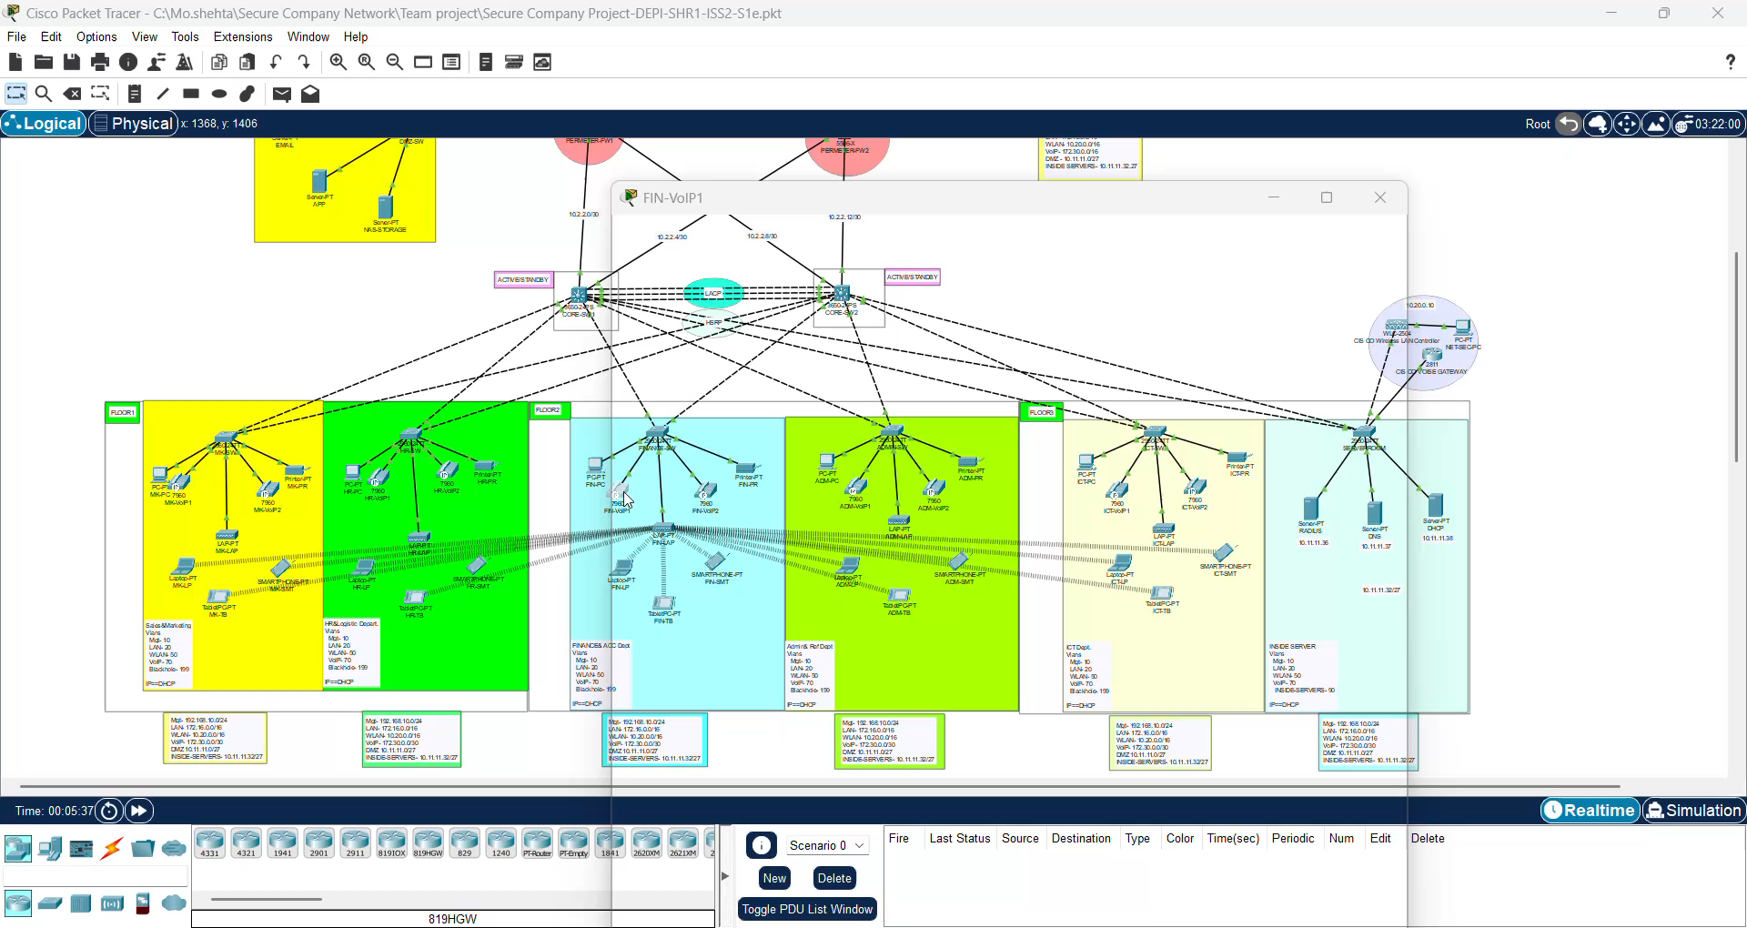
Verifying and Test Configuration
Using IP-phones

Slide 24
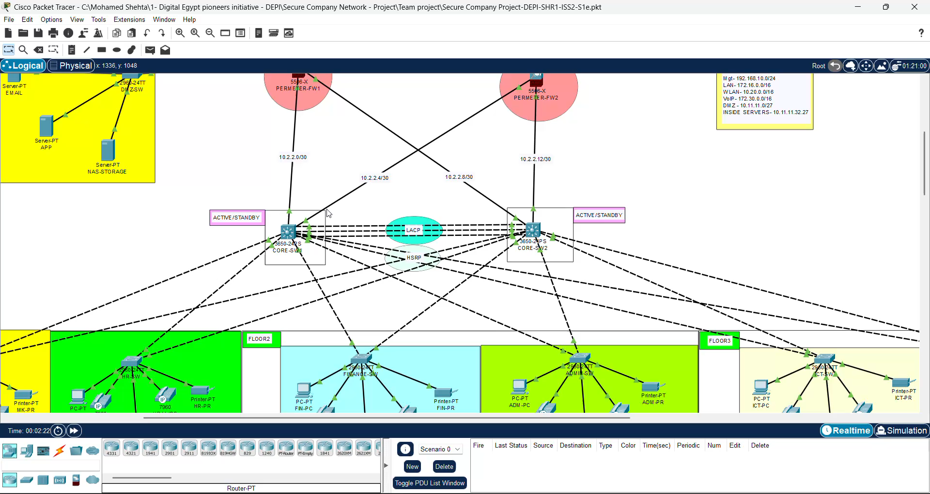
Verifying and Test Configuration
NET-SEC-PC

Slide 25
Network Security - Firewalls Overview
A detailed look at the firewalls within
the network architecture.

Slide 26
Introduction to Firewalls in Network Security
Definition:-
A firewall is a network security device that monitor and controls incoming and outgoing traffic based on predetermined security rules.
Purpose:-
To create a barrier between a trusted internal network and untrusted external networks, such as the internet.
Types of Firewalls:-
Hardware Firewall:- Cisco ASA (Advanced Security Appliance).
Software Firewall:-
Included in various operating systems.

Slide 27
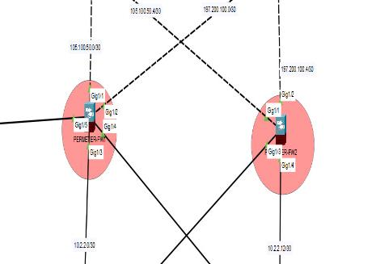
Firewall Types in the Project
Cisco ASA Firewall:-
Protects the internal network by filtering and inspecting traffic.
Supports stateful inspection of packets.
Manages traffic between different zones
(e.g., LAN, DMZ, WLAN).
Access Control Lists (ACLs):-
Applied to control traffic flow.
Inbound and Outbound Filters:-
Define which traffic is allowed or
denied based on IP addresses,
protocols, and ports.

Slide 28
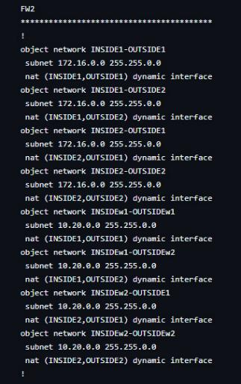
Security Features Implemented in the Project
Firewall Zones:-
Inside Zone:- Trusted internal network.
Outside Zone:- Untrusted external network (Internet).
DMZ (Demilitarized Zone):-
A neutral zone to host public-facing servers while protecting internal assets.
Access Control and Security Policies:-
ACLs to restrict access based on IP, port numbers, and services.
Stateful Packet Inspection:-
Ensures only valid connections pass through the firewall.

Slide 29
Network Security & Future Expansion
Security Features:-
- ACLs, RADIUS authentication for secure device access, VLAN segmentation.
- DHCP, DNS, and RADIUS servers ensure efficient and secure network operations.
Future Expansion:-
- Scalable to add more departments or devices.
- Plan to enhance network capacity, including additional server room resources.

Slide 30
Conclusion
In conclusion, this project delivers a robust, scalable, and secure network solution tailored to the organization’s needs. The design ensures redundancy, efficient data flow, and secure communication between departments. By leveraging advanced technologies like OSPF, VLANs, and DHCP, the network is prepared for both current demands and future growth. This solution will enable seamless operations and support the company’s ongoing expansion.

Slide 31

Thanks Supervised By:- ENG. Hossam Eltahan

